Slide 1

Poverty Matters Conference November 18, 2015
Medicaid Birth Cost Recovery Policy: Impacts on Low-Income Pregnant Women and Families
Bobby Peterson
Executive Director
ABC for Health, Inc.
© 2015 ABC For Health, Inc. No Reprint or use without express written permission of ABC for Health, Inc.

Slide 2
ABC for Health, Inc., Madison
ABC for Rural Health, Inc., Balsam Lake
Legal Services, Health Benefits Counseling, Outreach, Education and Training
  Access to health care coverage or services issues
  Terminations or denials of care or coverage
  Troubleshooting Medicaid/BadgerCare Plus eligibility issues
  Coordinating health coverage transitions and blanket coverage options
  Information and advocacy about HealthCheck services
  Outreach and Education through HealthWatch Wisconsin
© 2015 ABC For Health, Inc. No Reprint or use without express written permission of ABC for Health, Inc.

Slide 3
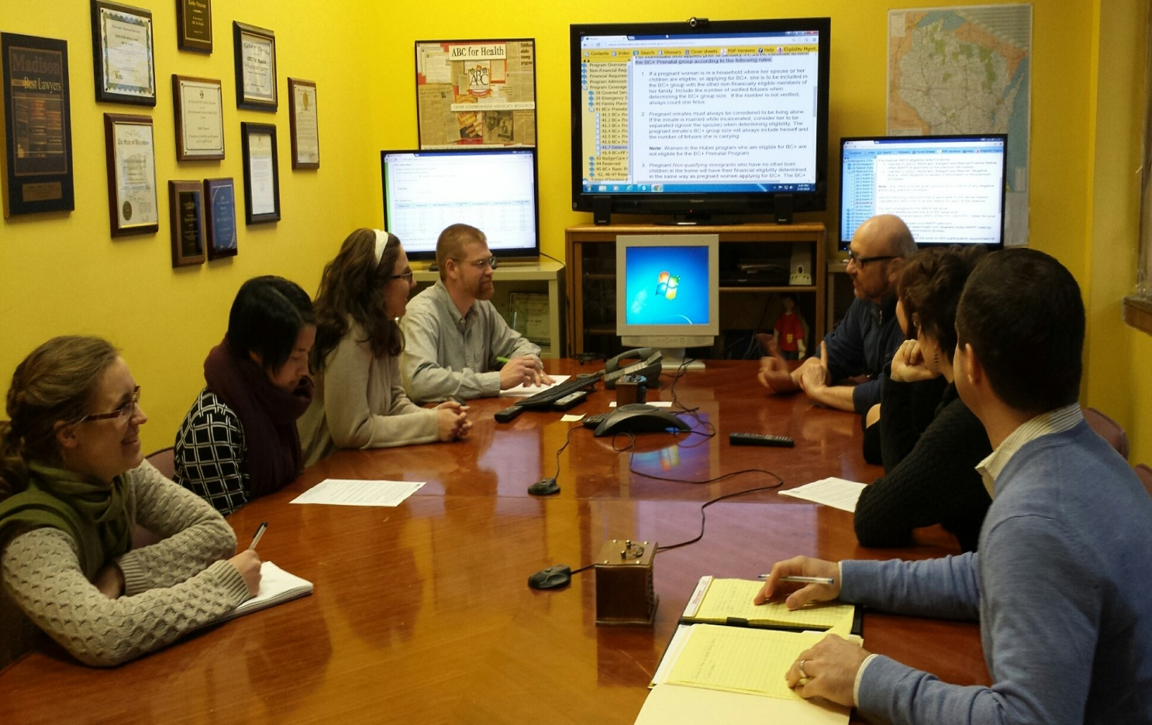
Client Services
Health Benefits Counseling
Case meeting process
A learning laboratory
© 2015 ABC For Health, Inc. No Reprint or use without express written permission of ABC for Health, Inc.

Slide 4

COVERAGE!
Immigrant Health
Crime Victims
Social Security Disability
EBD Disability
Veterans Benefits
SSI
Private Health Insurance
IRIS
Katie Beckett
Private Health Insurance
WWMA
Social Security Disability
BC+ PP
Charity Care
BadgerCare Plus
Katie Beckett
Medicare
SeniorCare
Marketplace
W-2
SEP
Medicare
SSI-E
EMA
COBRA
BC+ PP
Childless Adult
CEN
WWWP
Eligibility Assessment?
© 2015 ABC For Health, Inc. No Reprint or use without express written permission of ABC for Health, Inc.
Notes:
Why wait for the process to turn into collections?

Slide 5
How did ABC for Health staff identify Birth Cost Recovery as an Issue?
Mike Rust-- Health Benefits Counseling 90’s
Client Services Review for Pregnant Women
  Pregnant women clients
  Single mothers in the NICU
  Fathers in the household
  Implications for mother and newborn
© 2015 ABC For Health, Inc. No Reprint or use without express written permission of ABC for Health, Inc.
Notes:
Why wait for the process to turn into collections?

Slide 6
What is “Birth Cost Recovery?”
Birth costs, also called “lying in costs” are all Medicaid-related medical bills and expenses associated with prenatal care, pregnancy and birth of a child.
State can try to re-coup charges from father after the birth
Recovery effort from father is through local child support agencies (CSAs)
Mother cannot be charged directly
Does not apply to all births
© 2015 ABC For Health, Inc. No Reprint or use without express written permission of ABC for Health, Inc.

Slide 7
Who Does Birth Cost Recovery Apply To?
  BCR applies to pregnant unmarried women who used Medicaid for pre-natal/pregnancy care
  Policy may not apply to unmarried parents who have already had one child together
© 2015 ABC For Health, Inc. No Reprint or use without express written permission of ABC for Health, Inc.

Slide 8
Who Does Birth Cost Recovery Apply To?
Unmarried parents when the mother applies for BadgerCare Plus and the mother is referred to child support.
Birth costs include health care costs related to the pregnancy, as well as the birth of the child…
© 2015 ABC For Health, Inc. No Reprint or use without express written permission of ABC for Health, Inc.

Slide 9
Who Does Birth Cost Recovery Apply To?
(continued)
If the family is not referred to the Child Support program, the father will not have to repay birth costs to the BadgerCare Plus program.
An unmarried father might not have to repay birth costs if:
  The couple already had an older child together, and
  The couple told the BadgerCare Plus identified the father as living in the home before their new baby was born (so that his income was included in the family income when applying for BadgerCare Plus).
© 2015 ABC For Health, Inc. No Reprint or use without express written permission of ABC for Health, Inc.

Slide 10
Reporting the Father’s Name
  Pregnant woman are “required” to identify the father at the time of application for BC+/Medicaid services
    Wisconsin cannot deny Medicaid services to a pregnant woman for refusing to identify the father
    Practical results in communities?
            Delayed prenatal care?
            Poor birth outcomes?
            Increased infant mortality?
© 2015 ABC For Health, Inc. No Reprint or use without express written permission of ABC for Health, Inc.

Slide 11
    “Good Cause”
  Women can seek “Good Cause” exception to rule in cases where physical or emotional violence is likely (Threats of violence apply)
    They should ask their caseworker to help them complete a “Good Cause Case” exemption form
    Only 44 Good cause requests identified the last time we looked at data from 2011
© 2015 ABC For Health, Inc. No Reprint or use without express written permission of ABC for Health, Inc.

Slide 12
Birth Cost Recovery
“Good Cause”
Cooperation would make it more difficult to escape domestic abuse or risk of abuse;
The child was born as a result of sexual assault or incest;
A petition for adoption of the child is filed or the mother is working with an agency that is helping decide if the mother will place her child for adoption.
Wis. Stat. § 767.89(3)(e); Wis. Admin. Code. DCF 150.05(2)
© 2015 ABC For Health, Inc. No Reprint or use without express written permission of ABC for Health, Inc.

Slide 13
Good Cause--Steps
Identify reasons for not identifying the baby’s father.
to IM worker for “good cause”
Ask for a “Good Cause Claim Form.”
Complete and return the claim form to her worker.
Submit requested items of “proof”
The IM worker should help secure “proof”
If good cause is refused, appeal OR, withdraw the application or request a hearing.
Note: Under no circumstances will the absent parent be contacted
© 2015 ABC For Health, Inc. No Reprint or use without express written permission of ABC for Health, Inc.

Slide 14
Birth Cost Recovery
  BCR judgments issued against fathers in paternity orders.
  Judgment amount based on one half of average regional birth costs or actual costs and can be reduced for lower income payers.
  Orders include total amount of BCR judgment and monthly repayment requirements.
  Father is ordered to repay judgment amount to the state (not the mother).
Wis. Stat. § 767.89(3)(e); Wis. Admin. Code. DCF 150.05(2)
© 2015 ABC For Health, Inc. No Reprint or use without express written permission of ABC for Health, Inc.

Slide 15
Sanctions
  Woman cannot be denied Medicaid services while pregnant but…
  …they can be denied Medicaid services for failure to cooperate with child support post-partum
  Unpaid birth cost debt becomes a child support arrearage
© 2015 ABC For Health, Inc. No Reprint or use without express written permission of ABC for Health, Inc.

Slide 16
Do other states do this?
Wisconsin is one of only 9 states that seeks BCR from its Medicaid population
Of those 9 states, Wisconsin and Michigan are most aggressive with 2/3 of all actions nationally
41 other states have abandoned collection of BCR entirely
In 2011 WI collected around $18 million for Medicaid through this mechanism (15% county bounty)
© 2015 ABC For Health, Inc. No Reprint or use without express written permission of ABC for Health, Inc.

Slide 17
How many people does this impact?
About 50% of all WI births are to women insured by Medicaid. (Over 19,000 births)
67% of those women are unmarried and impacted by Birth Cost Recovery Policy
Consider Milwaukee County: 61% of deliveries are to women insured by Medicaid, 80% of whom are unmarried.
Birth Cost Recovery impacts half of Milwaukee County’s births.
© 2015 ABC For Health, Inc. No Reprint or use without express written permission of ABC for Health, Inc.

Slide 18
BCR Policy Implications:
Support for low income pregnant women and children? NO
Impedes early access to prenatal care and coverage? YES
Impact on poor birth outcomes? Most Likely
Impact on Infant mortality? Most Likely
© 2015 ABC For Health, Inc. No Reprint or use without express written permission of ABC for Health, Inc.

Slide 19
Birth Cost Recovery-Marketplace
  Imposes unexpected financial consequences on cohabiting mothers who choose BC+ over Marketplace insurance.
  Women eligible for BC+ under higher income threshold (300% FPL) must choose between Marketplace tax credits and BC+. Cannot get Marketplace APTCs and also use BC+ as wrap-around coverage.
  High Marketplace deductibles make BC+ a better financial choice for most…….But BCR Looms
© 2015 ABC For Health, Inc. No Reprint or use without express written permission of ABC for Health, Inc.

Slide 20
Birth Cost Recovery
In some cases using “imputed income” mothers (in co-parent households) actually end up paying BCR.
During our research the state ordered county offices of child support enforcement not to publicly disclose their actual local practices governing BCR.
Some puzzling information about costs charged across Wisconsin follows
© 2015 ABC For Health, Inc. No Reprint or use without express written permission of ABC for Health, Inc.

Slide 21
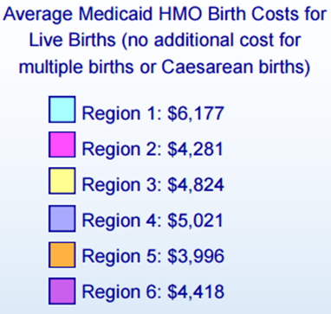
© 2015 ABC For Health, Inc. No Reprint or use without express written permission of ABC for Health, Inc.

Slide 22
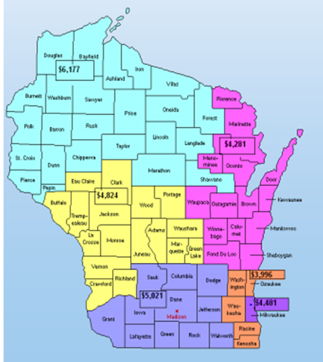
© 2015 ABC For Health, Inc. No Reprint or use without express written permission of ABC for Health, Inc.

Slide 23
Birth Cost Recovery
Proposed Policy Change
“Recovery of birth costs is inappropriate in cases where the alleged father is a member of an intact family that includes the mother and the subject child, and the father’s income, if any, contributes to the support of the child.”
© 2015 ABC For Health, Inc. No Reprint or use without express written permission of ABC for Health, Inc.

Slide 24
Interaction Between BCR and
Pre-term Birth*(Dr Meghan Pesco)
Health Disparities in Infant Mortality in Wisconsin
Risk Factors for PTB
Biologic
Social
Poverty
  Individual
  Neighborhood
Lack of partner support and father involvement
Birth Cost Recovery Policy
Preterm Birth
Psychological
Maternal stress
Racism
Health Care Systems
Differential rates of enforcement
Late entry to pre-natal care
Gaps in insurance coverage (coverage only for prenatal care)
Sanctioning

Slide 25
Sources:
BadgerCare Plus Handbook 5.1 Medical Support
www.emhandbooks.wisconsin.gov/bcplus/policyfiles/2/05/5.1.htm
BadgerCare Plus Handbook 5.2 Cooperation
www.emhandbooks.wisconsin.gov/bcplus/policyfiles/2/05/5.2.htm
BadgerCare Plus Handbook 5.3 Good Cause
www.emhandbooks.wisconsin.gov/bcplus/policyfiles/2/05/5.3.htm
© 2015 ABC For Health, Inc. No Reprint or use without express written permission of ABC for Health, Inc.

Slide 26
Policy Cost-Benefit Analysis
Policy benefits:
  Immediate $$ savings to Wisconsin taxpayers/Medicaid program
Policy costs:
  Increased poverty to low-income families
  Reduced child support compliance among low-income fathers
  Decreased paternal support during pregnancy and beyond
  Delayed entrance to prenatal care by pregnant women
  Confusion regarding sanctioning and decreased inter-conceptional care among high-risk women
  Increased risk of prematurity through interactions with multiple risk factors
    Increased total health care costs (more $$ paid by taxpayers)
    Increased health disparities in infant mortality in Wisconsin
Notes:
Here Erin will discuss legislation proposed at state/federal level to eliminate BCR. Maybe we could also add something about what our proposed policy alternative is?

Slide 27
Recommendation
Given the multiple costs associated with maintaining Wisconsin’s current policy,
ABC for Health Inc. recommends that lawmakers eliminate the practice of birth cost recovery from unmarried fathers in the state of Wisconsin
State and local policymakers and grant programs should pay attention to the impact of birth cost recovery policy on health disparities in infant mortality

Slide 28
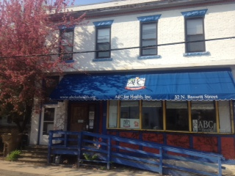
Thank you!
ABC for Health, Inc.
32 North Bassett Street
Madison, WI 53703
608-261-6939
www.abcforhealth.org
© 2015 ABC For Health, Inc. No Reprint or use without express written permission of ABC for Health, Inc.

